Slide 1


“THREE SWORDS, ONE HERETIC, NO MERCY”
BY SIGMA SQUAD: DANN KAOUSSARANI, MOHAMAD GHANMEH, DOMINIQUE CARTIER, JENNIFER OSORIO, ADRIEN KAMRAN, LE CHERNG LEE

Slide 2


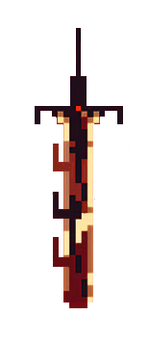
WHAT THE CRITICS HAD TO SAY…
Praise for the swords and general combat mechanics
Love for the art style
Interest was high overall
Emphasis on the need for proper game balance
Desire to see more of the enemies, puzzles, and narrative
Concerns regarding movement speed and UI size

Slide 3

WHAT WE COULDN’T INCLUDE…
No minibosses
No “arena” areas for testing sword mechanics
No direct methods of ensuring replayability

Slide 4
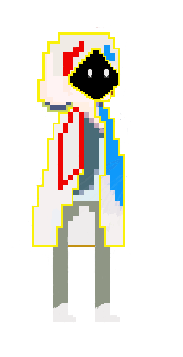
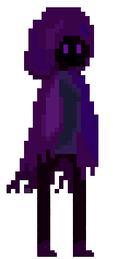
THE MOMENT YOU’VE ALL BEEN WAITING FOR…
https://www.youtube.com/watch?v=HGh5xCPHTVw
https://www.youtube.com/watch?v=f0_crjr3oxc

Slide 5

THANK YOU

